Slide 1

DEPI GRADUATION PROJECT
LAND TYPE CLASSIFICATION
PRESENTED BY OUR TEAM...
2025
DEPI

Slide 2
DEPI Final Project
01
PROJECT BRIEF
05
MODEL ARCHITECTURE
02
ABOUT DATA
06
TRAINING AND VALIDATION
03
EXPLORATORY DATA ANALYSIS
07
CONCLUSION
04
DATA PREPROCESSING
CONTENT
2025
Project Guidelines

Slide 3
PROJECT OVERVIEW
Objective:
Classify satellite images into different land use and land cover categories (e.g., Forest, Residential, River, etc.) using machine learning and deep learning techniques.
Dataset:
Source: EuroSAT — based on Sentinel-2 satellite imagery.
Structure: Images are organized into folders, each representing one of 10 land use classes.
Format: RGB and/or multispectral .jpg/.tif images, size usually 64x64.
Mohamed Reda
Project Overview
01
/ 12

Slide 4
WHAT YOU’LL DO (PROJECT STEPS):
EDA (Exploratory Data Analysis):
Visualize image samples from each class.
Plot image distribution per class.
Analyze image shapes, sizes, and color intensities.
Check balance of the dataset.
Preprocessing:
Resize/normalize images.
Optional: Convert to grayscale or reduce channels.
Data augmentation (e.g., flipping, rotation).
Model Building:
Baseline: Use traditional ML (like SVM, RandomForest) on flattened image features (optional).
Deep Learning: Use CNN (Convolutional Neural Networks) with PyTorch/Keras/TensorFlow.
Optional: Transfer learning using pretrained models like ResNet or VGG.
Messages from CEO
01
/ 12

Slide 5
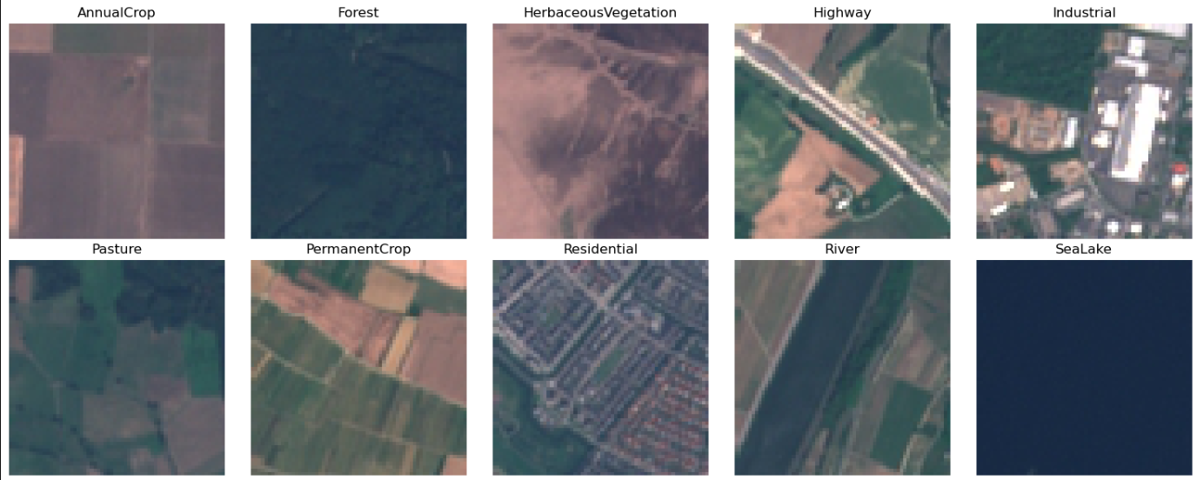
ABOUT DATA:
Classes:
AnnualCrop
Forest
HerbaceousVegetation
Highway
Industrial
Pasture
PermanentCrop
Residential
River
SeaLake
Data Stats:
Total Images: ~27,000+
Images per Class: ~2,000 to 3,000 (almost balanced)
Resolution: Medium — not super detailed, but great for ML tasks.
What is it?
EuroSAT is a labeled satellite imagery dataset based on Sentinel-2 satellite data, designed for land use and land cover classification. It’s perfect for training models to understand Earth's surface patterns.
About Us
02
/ 12

Slide 6
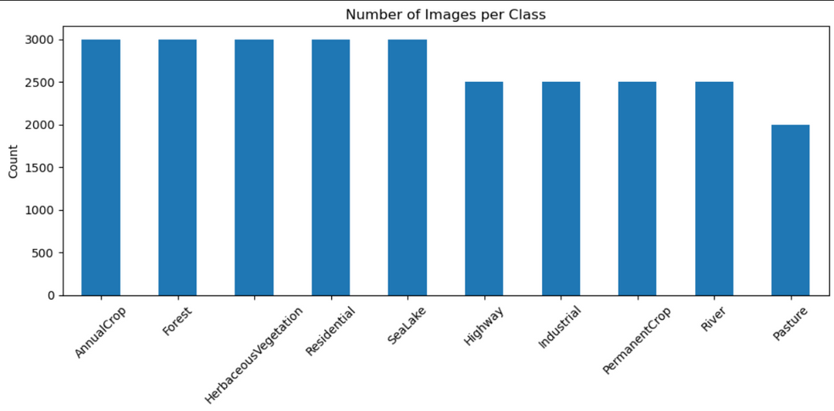
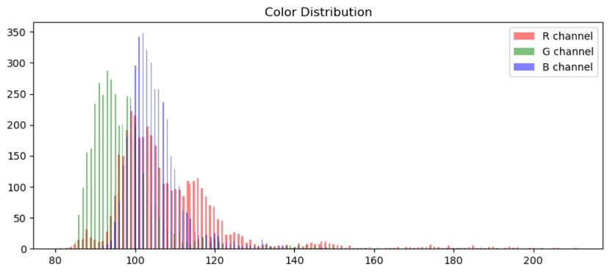
EXPLORATORY DATA ANALYSIS (EDA):
Class Distribution Summary:
Highly imbalanced dataset
Top classes: "Annual/CRP" (2500-3000), "Forest" (2000-2500)
Bottom classes: "Highway", "Industrial", "Pasture" (<500 each)
Key Concern:
Model may struggle with rare classes due to extreme imbalance.
Solution:
Apply class weights or oversample rare classes during training.
DEPI Final Project
Shows RGB channel histograms from a sample image.
Reveals pixel intensity distribution (0-255) per channel.
Typical natural image profile with:
Peaks in mid-range values
Long tails at extremes
Helps detect color bias.
Useful for checking dataset color characteristics before augmentation/normalization.
EDA
03
/ 12

Slide 7
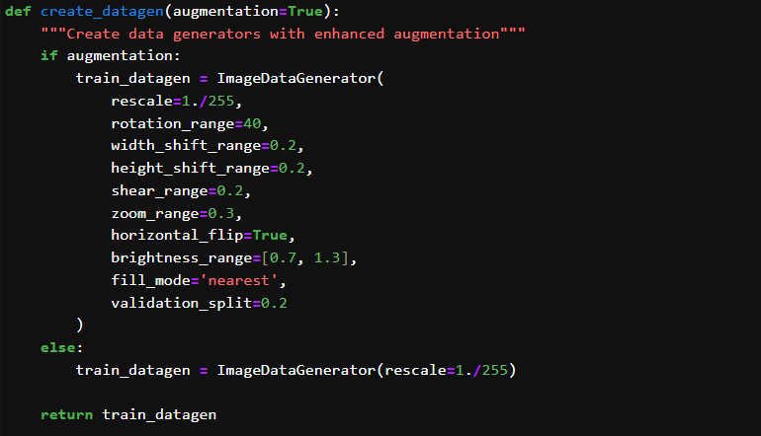
DATA PREPROCESSING:
This function creates a ImageDataGenerato with two modes:
1. Augmentation Mode (default):
Applies 8 transformations: rotation, shifts, shear, zoom, flip, brightness adjustment
Normalizes pixels (1./255)
Uses 20% data for validation
Fills empty pixels with nearest neighbor
2. Basic Mode
Only performs pixel normalization
Purpose: Enhances training data variety to improve model generalization.
DEPI Final Project
Data Preprocessing
04
/ 12

Slide 8
DATA PREPROCESSING (CONT...):
This function creates three data generators:
Training Generator:
Uses augmented data (rotations, flips, etc.).
80% of data (specified by `subset='training'`).
Batched for efficient training.
2.Validation Generator:
Same augmentation as training (prevents mismatch).
20% of data (subset='validation').
3.Test Generator
No augmentation, batch size = 1 (for accurate evaluation)
Disables shuffling for consistent results
Key Features:
✔️ Enforces reproducibility with fixed `seed`
✔️ Saves class-to-index mapping for deployment
✔️ Supports custom class order via `CLASS_NAMES`
def get_data_generators():
"""Create train/validation/test generators"""
train_datagen = create_datagen(augmentation=True)
test_datagen = create_datagen(augmentation=False)
train_generator = train_datagen.flow_from_directory(
DATA_PATH,
target_size=IMG_SIZE,
batch_size=BATCH_SIZE,
class_mode='categorical',
subset='training',
seed=SEED,
classes=CLASS_NAMES
)
val_generator = train_datagen.flow_from_directory(
DATA_PATH,
target_size=IMG_SIZE,
batch_size=BATCH_SIZE,
class_mode='categorical',
subset='validation',
seed=SEED,
classes=CLASS_NAMES
)
test_generator = test_datagen.flow_from_directory(
DATA_PATH,
target_size=IMG_SIZE,
batch_size=1,
class_mode='categorical',...
Data Preprocessing
04
/ 12

Slide 9
Model Architecture:
def create_model():
"""Create enhanced CNN model with preprocessing layers"""
model = models.Sequential([
# Input preprocessing
preprocessing.Rescaling(1./255, input_shape=(*IMG_SIZE, 3)),
preprocessing.RandomRotation(0.1),
preprocessing.RandomZoom(0.1),
# Convolutional Base
layers.Conv2D(64, (3, 3), activation='relu', padding='same'),
layers.BatchNormalization(),
layers.MaxPooling2D((2, 2)),
layers.Conv2D(128, (3, 3), activation='relu', padding='same'),
layers.BatchNormalization(),
layers.MaxPooling2D((2, 2)),
layers.Conv2D(256, (3, 3), activation='relu', padding='same'),
layers.BatchNormalization(),
layers.MaxPooling2D((2, 2)),
layers.GlobalAveragePooling2D(),
# Classifier
layers.Dense(512, activation='relu'),
layers.Dropout(0.5),
layers.Dense(len(CLASS_NAMES), activation='softmax')
])
model.compile(optimizer=tf.keras.optimizers.Adam(learning_rate=1e-3),
loss='categorical_crossentropy',
metrics=['accuracy'])
return model
Core Structure:
Input Preprocessing: Built-in normalization (+ random rotation/zoom augmentation)
Convolutional Base:
3 Conv2D blocks (64 → 128 → 256 filters) with BatchNorm and max pooling
GlobalAveragePooling for dimensionality reduction
Classifier:
512-unit Dense layer with Dropout (50%)
Softmax output for multi-class prediction
Key Features:
✔️ Built-in augmentation (rotation + zoom)
✔️ Batch normalization for stable training
✔️ Global pooling reduces parameters vs Flatten
✔️ Adam optimizer (LR=1e-3) with categorical crossentropy
DEPI Final Project
Model Architecture
05
/ 12

Slide 10
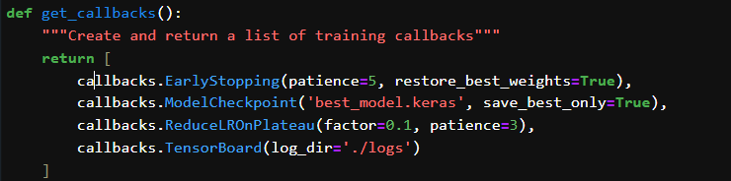
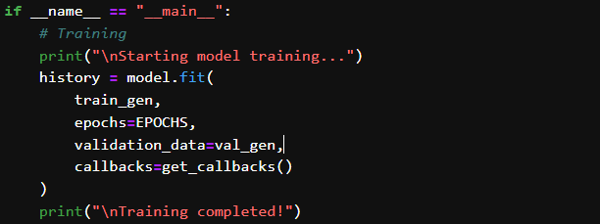
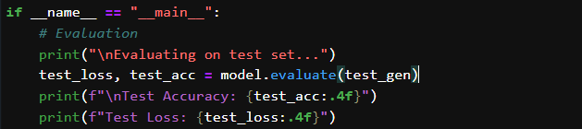
Training and Validation:
EarlyStopping: Halts training if no improvement after 5 epochs (restores best weights)
ModelCheckpoint: Saves best model automatically ('best_model.keras')
ReduceLROnPlateau: Cuts learning rate by 90% after 3 stagnant epochs
TensorBoard: Enables real-time training visualization
Launches model training with:
Epochs: Custom EPOCHS setting
Data: Uses train/validation generators
Callbacks: Applies automated optimization (early stopping, checkpoints, LR adjustment)
Progress: Prints start/end notifications
Output: Returns history object containing all training metrics.
Executes critical test-phase operations:
Rigorous Testing: Evaluates model on untouched test set
Key Metrics: Calculates loss and accuracy (4 decimal precision)
Clear Reporting: Prints formatted results for quick interpretation
Output: Returns exact performance metrics to gauge real-world applicability.
Training and Validation
06
/ 12

Slide 11
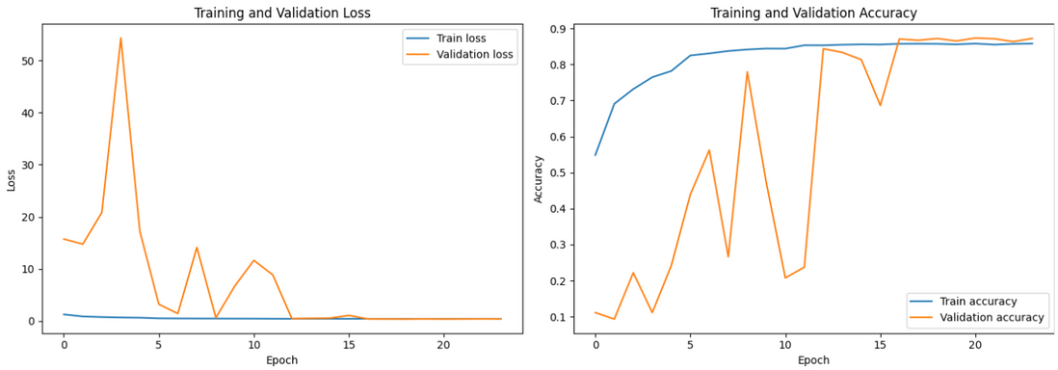
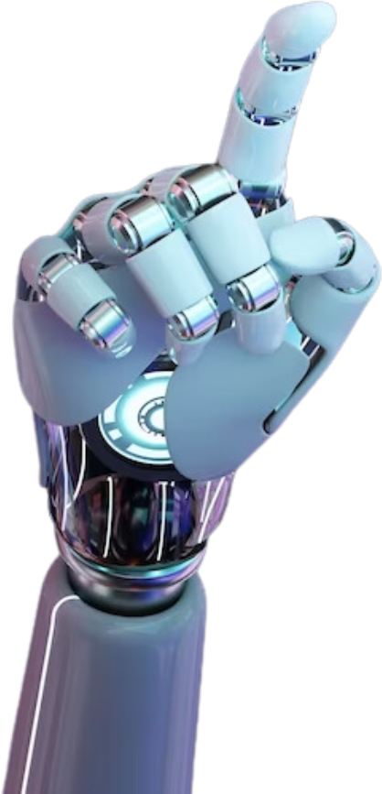
Training and Validation:
Loss Curve:
Both training and validation loss decrease steadily
No significant divergence, suggesting no severe overfitting
Final loss values near zero indicate good convergence
Accuracy Curve:
Training accuracy reaches ~90% (strong learning)
Validation accuracy stabilizes around ~80%
Small gap between curves shows moderate generalization
Key Insight:
Model learns effectively but may benefit from:
Regularization to reduce train-val gap
Early stopping around epoch 15
Training and Validation
07
/ 12

Slide 12
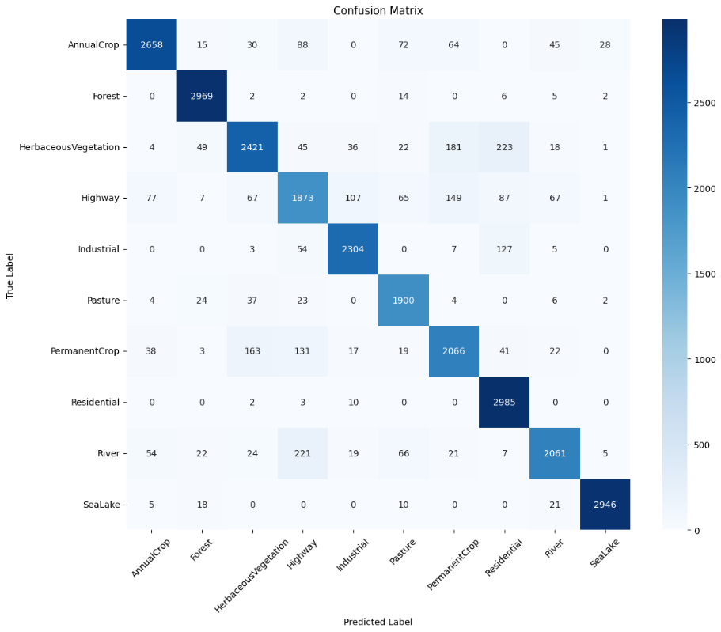
Training and Validation:
Confusion Matrix:
The confusion matrix provides a detailed breakdown of how well the trained model performs on the test dataset by comparing true labels to predicted labels.
Rows represent the actual classes (ground truth).
Columns represent the predicted classes.
Each cell [i, j] shows the number of times images from class i were predicted as class j.
Insights It Offers:
Diagonal cells show correct predictions — the higher these values, the better.
Off-diagonal cells show misclassifications — helping you spot which classes the model confuses.
Confusion Matrix
08
/ 12

Slide 13
Conclusion
✅ Successfully trained a deep learning model to classify satellite images into multiple land cover categories using the EuroSAT dataset.
🔍 Performed exploratory data analysis (EDA) to understand class distribution and visualize sample images from each class.
📊 Evaluated model performance using a confusion matrix, identifying both strengths and common misclassification patterns.
💡 Data augmentation and normalization helped improve generalization and model robustness.
🌍 The project demonstrates the potential of AI in geospatial analysis and remote sensing applications, supporting smarter land use and environmental monitoring.
Brand Guidelines
Conclusion
09
/ 12

Slide 14
SAY HI TO THE TEAM
DEPI Final Project
Team Members:
Mohamed Reda ALi
Morad Asker Hassan
Ayman Mohamed El-desoky
Samy Mostafa El-yazory
Abdelrahman Ahmed Mahmoud
Team
Team
10
/ 12

Slide 15

THANK YOU
DEPI
Feel free to give feedback and input
m07hamedreda25@gmail.com
+201068145227
DEPI Final Project
Thank You
2025

